Slide 1
OpenDSS Training Workshop
Consolidated Edison Co.
New York, NY
Roger C. Dugan
Davis Montenegro
EPRI Knoxville, TN
October 17-18, 2019

Slide 2
6. Intro to OpenDSS Parallel Machine
Version 8

Slide 3


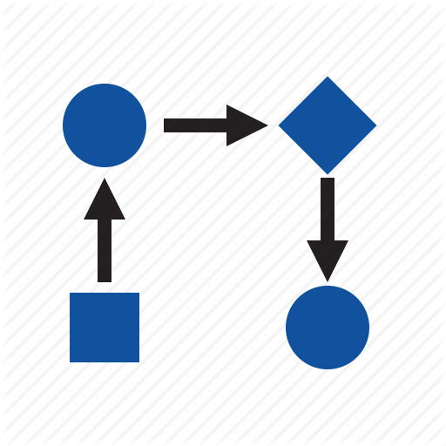

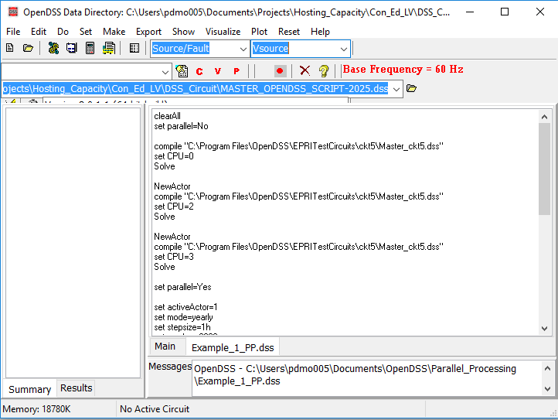
The evolution of OpenDSS into a parallel computing machine
After being released in 2008 as open source software OpenDSS has become widely used around the world. One of the features that makes OpenDSS popular is that the package offers interfaces for co-simulation.

Slide 4
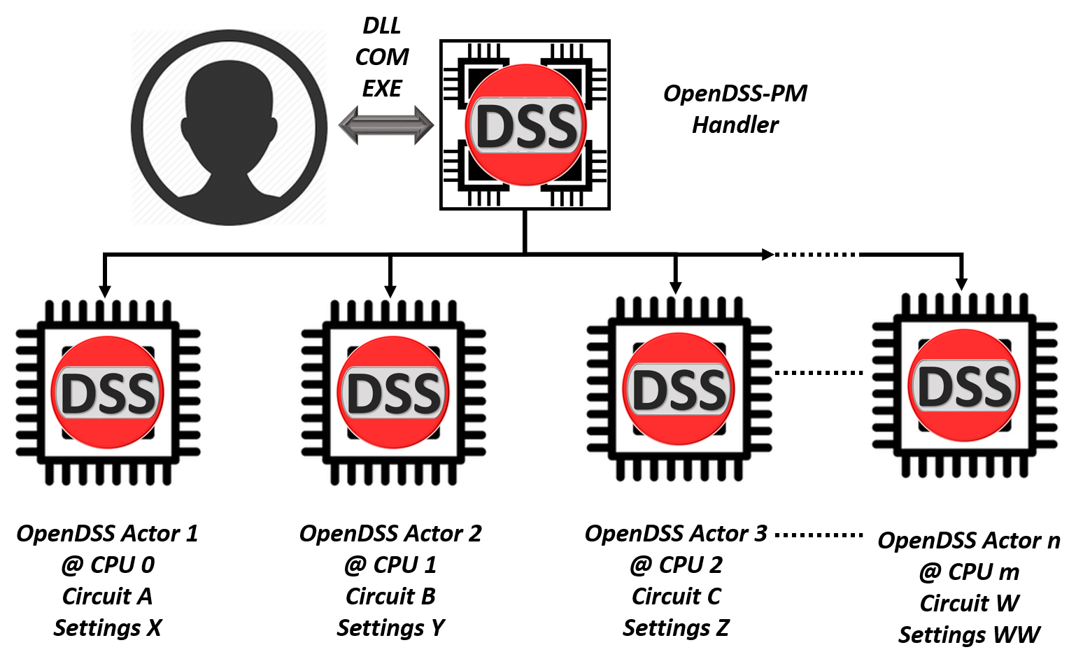
The evolution of OpenDSS into a parallel computing machine

Slide 5
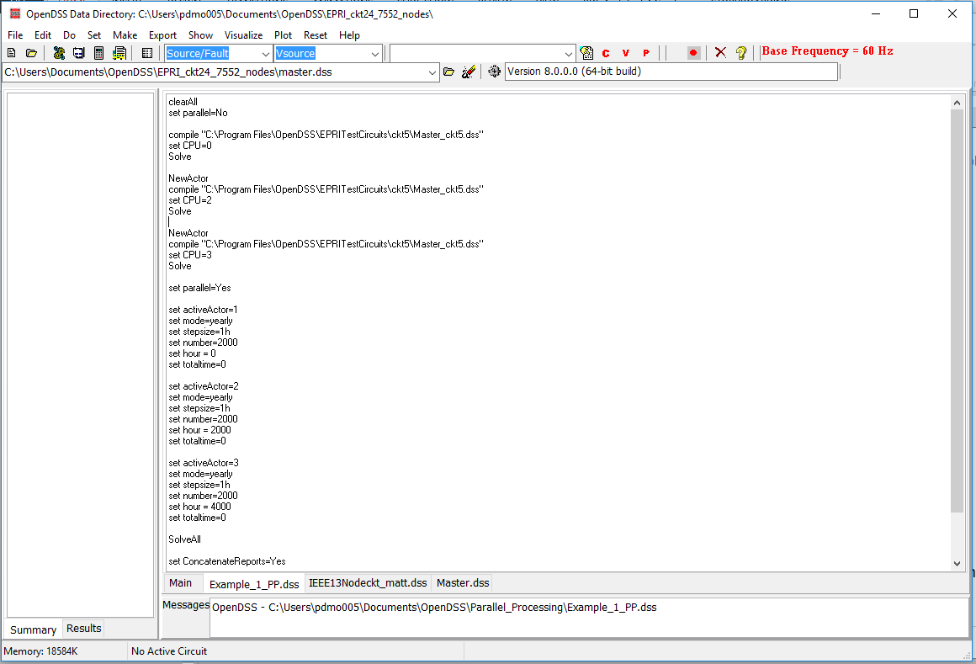

The evolution of OpenDSS into a parallel computing machine
These features have been implemented into the existing interfaces preserving the format and adding instructions to the instruction set

Slide 6
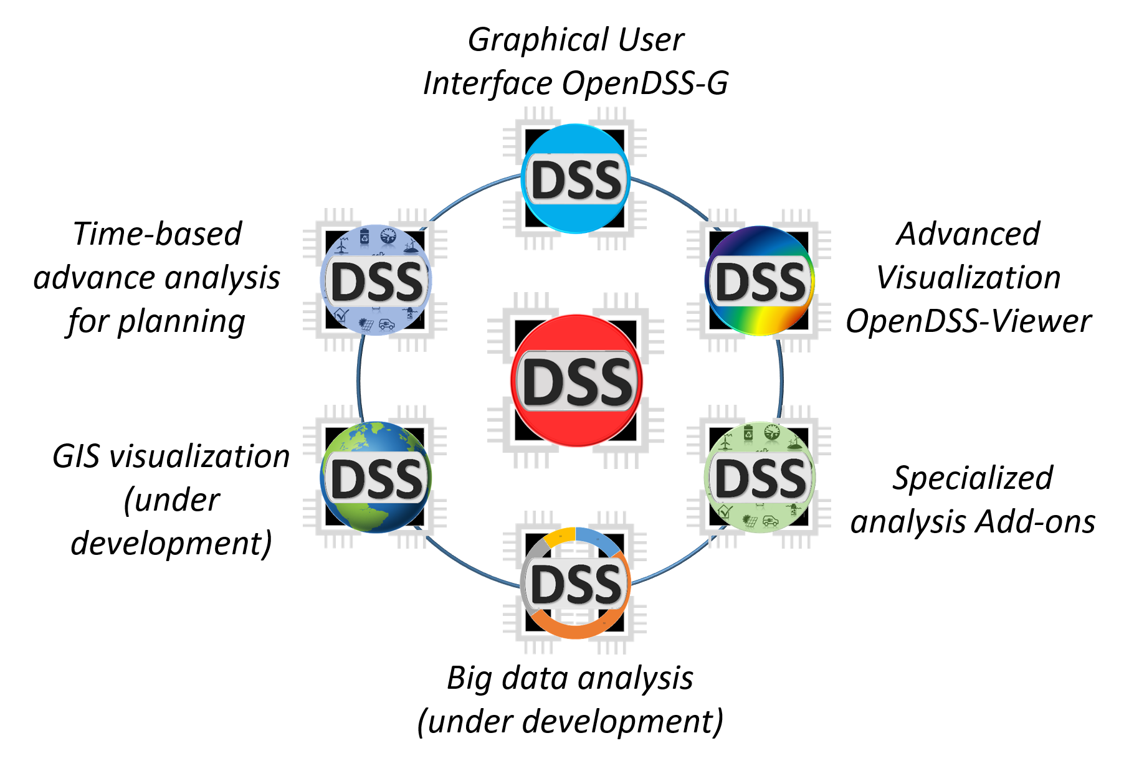
The tools for attending the new challenges
https://www.epri.com/#/pages/sa/opendss?lang=en

Slide 7
The evolution of OpenDSS into a parallel computing machine
There is a new set of functions and instructions related with parallel processing, topology analysis and more that can be used using the same DSS command environment
NumCPUs | ClearAll | Tear_Circuit
NumCores | Wait | Export IncMatrix
NewActor | Parallel | Export IncMatrixRows
NumActors | SolveAll | Export IncMatrixCols
ActiveActor | ConcatenateReports | Export BusLevels
CPU | CalcIncMatrix | ADiakoptics
ActorProgress | CalcIncMatrix_o | Refine_BusLevels
Abort | CalcLaplacian | Export Laplacian
Clone | LinkBranches | Contours
ZLL | ZCC | Y4
Num_SubCircuits

Slide 8
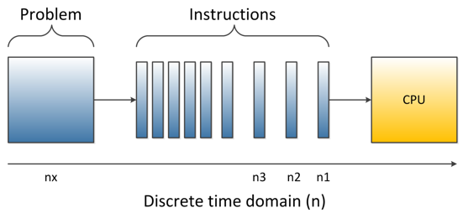
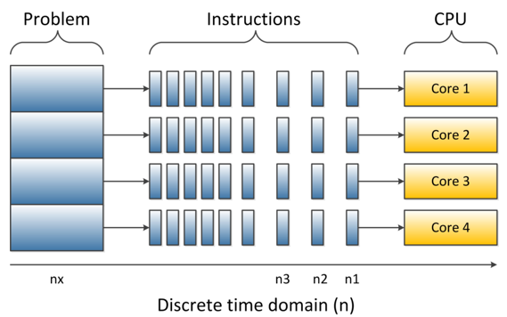
How far can you get with your computer in multi-core
Depending on your computer features and the understanding that you have about them it will depend how far can you go with parallel processing

Slide 9
How far can you get with your computer in multi-core
Thread 0 (CPU)
Core
Thread 1 (CPU)
Depending on your computer features and the understanding that you have about them it will depend how far can you go with parallel processing

Slide 10
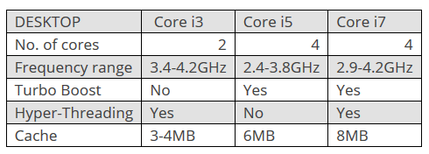

How far can you get with your computer in multi-core
CPU 1
CPU 0
Core
http://www.trustedreviews.com/opinion/best-intel-processor-core-i3-i5-i7-2937692
Depending on your computer features and the understanding that you have about them it will depend how far can you go with parallel processing

Slide 11
How far can you get with your computer in multi-core
CPU 0
Core
CPU 0
CPU 1
CPU 2
Core
CPU 2
CPU 3
Depending on your computer features and the understanding that you have about them it will depend how far can you go with parallel processing

Slide 12
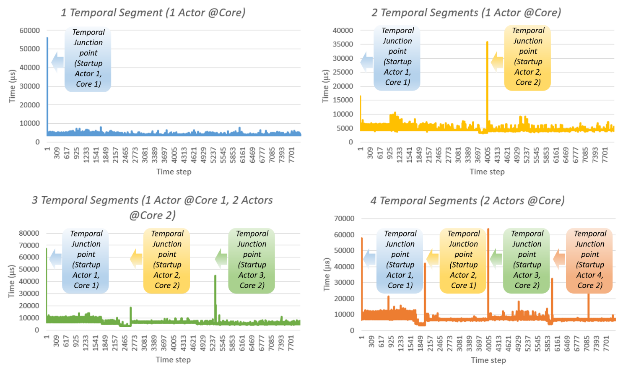
Temporal parallelization
“The computational burden is on the simulation intensity”

Slide 13
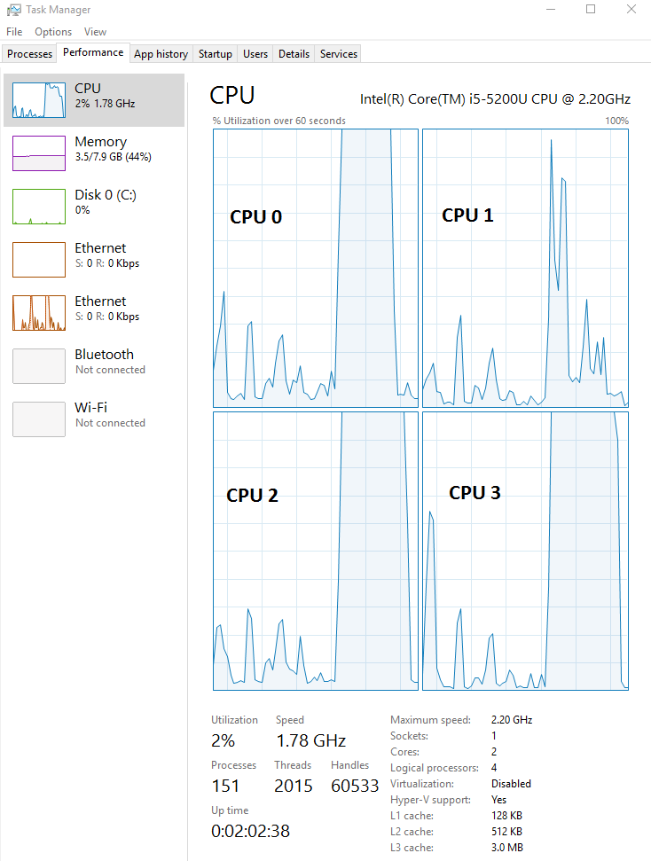
Temporal parallelization
“The computational burden is on the simulation intensity”
clearAll
set parallel=No
compile "C:\Program Files\OpenDSS\EPRITestCircuits\ckt5\Master_ckt5.dss"
set CPU=0
Solve
Clone 2
set parallel=Yes
set activeActor=*
set mode=yearly number=2000 totaltime=0
Set ActiveActor=1
Set hour=0
set activeActor=2
set hour = 2000
set activeActor=3
set hour = 4000
SolveAll
Wait
get actorprogress
set ConcatenateReports=Yes
show monitor MS2

Slide 14
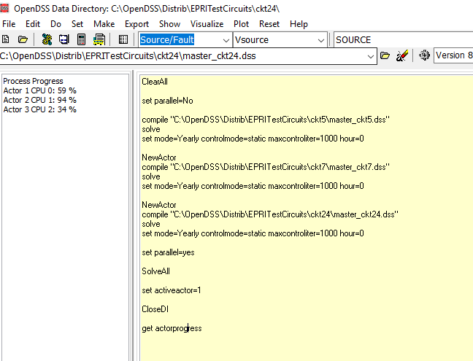
Temporal parallelization
“The computational burden is on the simulation intensity”

Slide 15
Temporal parallelization
“The computational burden is on the simulation intensity”
The examples for parallel processing can be downloaded from:
https://sourceforge.net/p/electricdss/code/HEAD/tree/trunk/Version8/Distrib/Examples/Parallel_Processing
These examples involves MATLAB and python.
Other examples for LabVIEW through the VI Package Manager

Slide 16
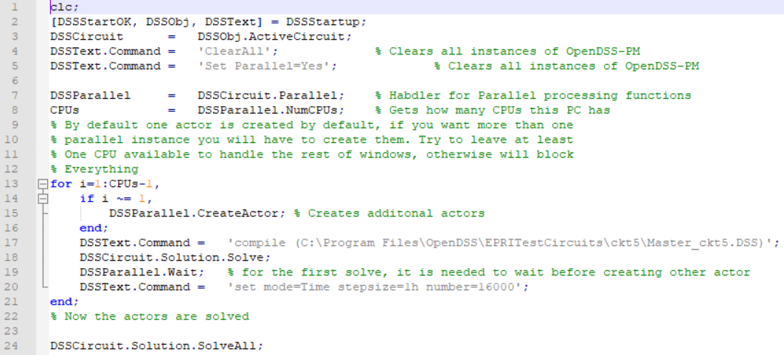
Temporal parallelization
“The computational burden is on the simulation intensity”
Example # 1 MATLAB

Slide 17
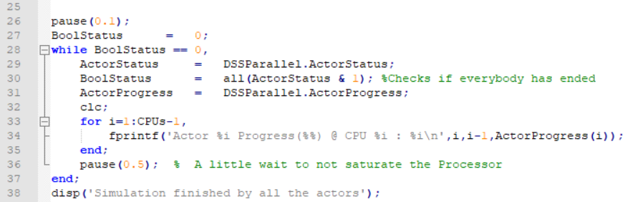
Temporal parallelization
“The computational burden is on the simulation intensity”
Example # 1 MATLAB

Slide 18
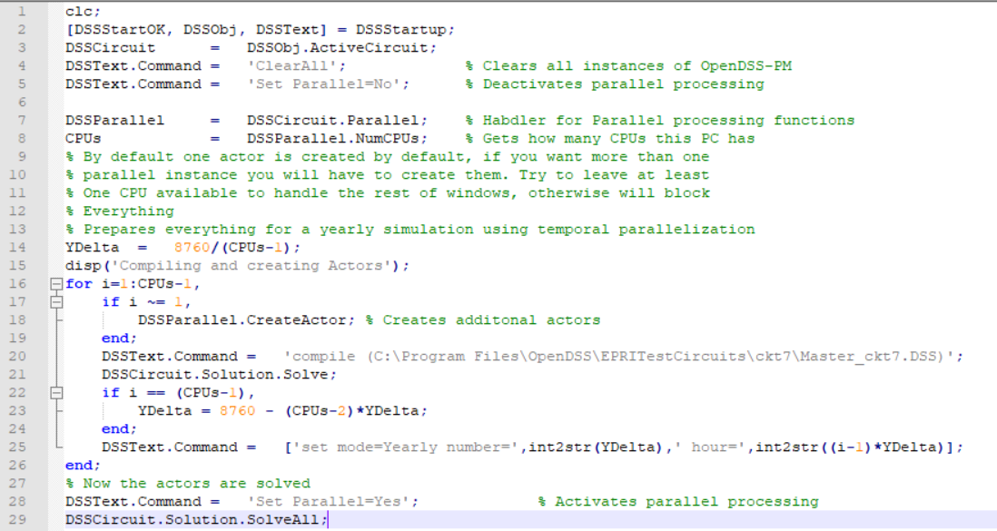
Temporal parallelization
“The computational burden is on the simulation intensity”
Example # 2 MATLAB

Slide 19
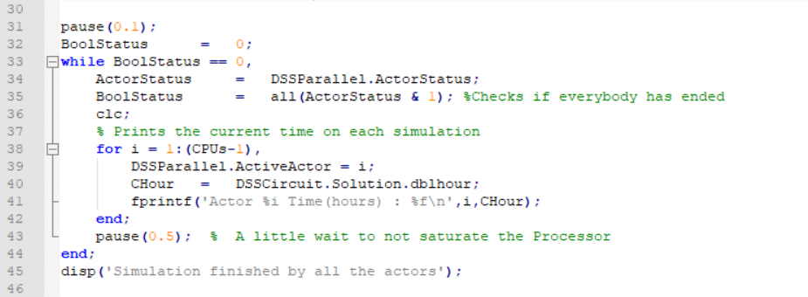
Temporal parallelization
“The computational burden is on the simulation intensity”
Example # 2 MATLAB

Slide 20
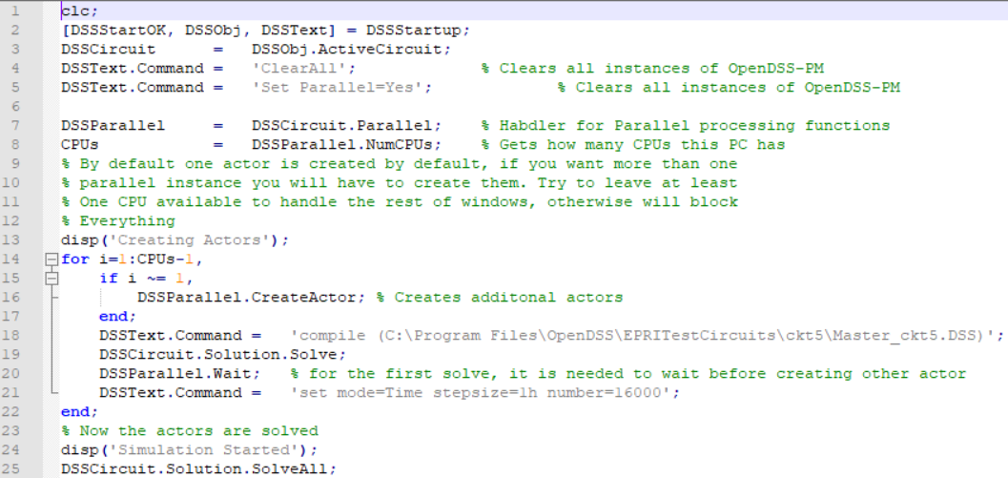
Temporal parallelization
“The computational burden is on the simulation intensity”
Example # 3 MATLAB

Slide 21
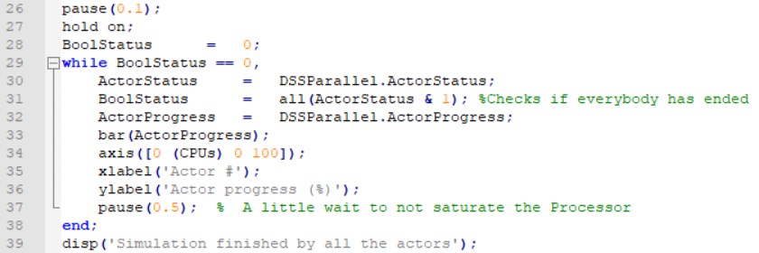
Temporal parallelization
“The computational burden is on the simulation intensity”
Example # 3 MATLAB

Slide 22
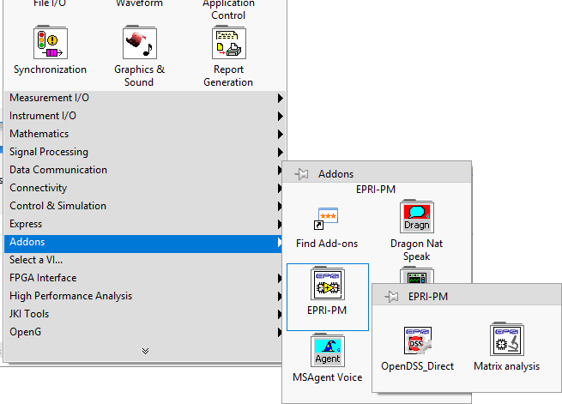
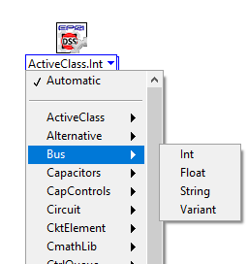
Temporal parallelization
“The computational burden is on the simulation intensity”
Using the OpenDSS-PM library for NI LabVIEW

Slide 23
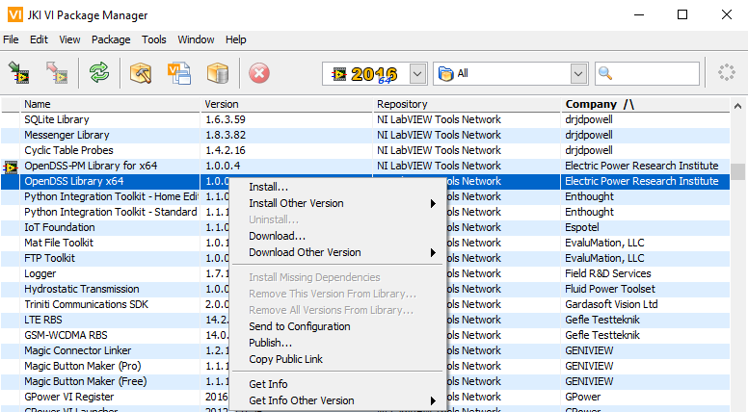

Temporal parallelization
“The computational burden is on the simulation intensity”
Using the OpenDSS library for NI LabVIEW

Slide 24
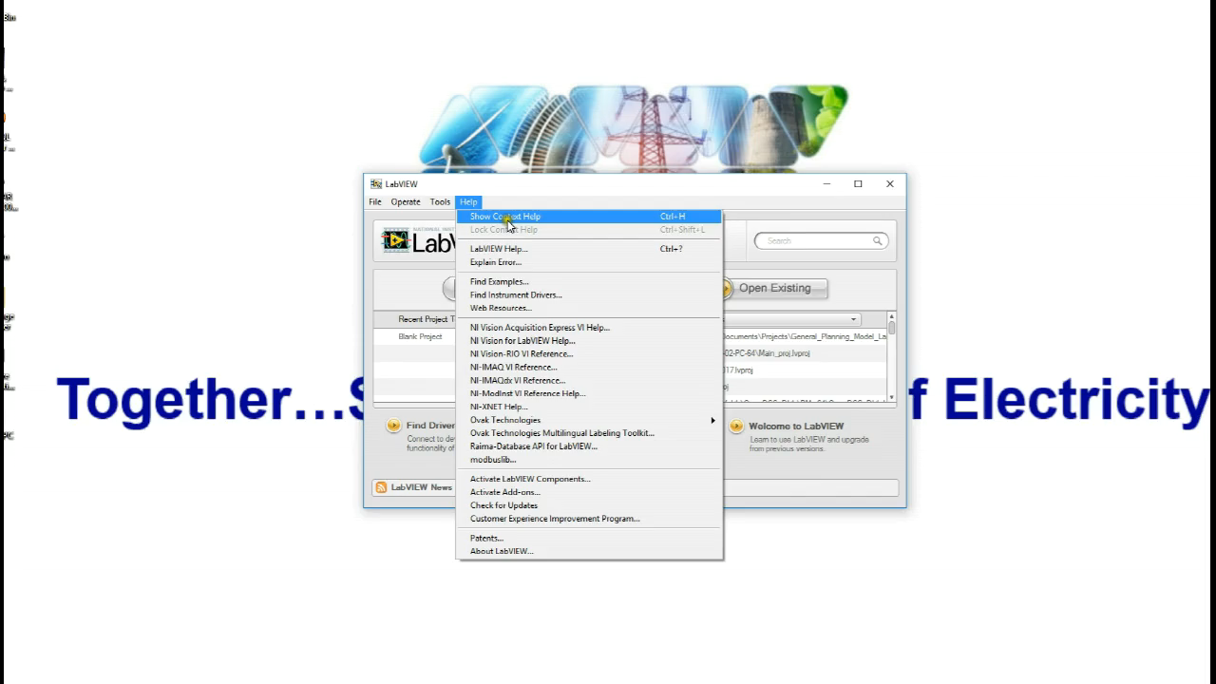
Temporal parallelization
“The computational burden is on the simulation intensity”

Slide 25
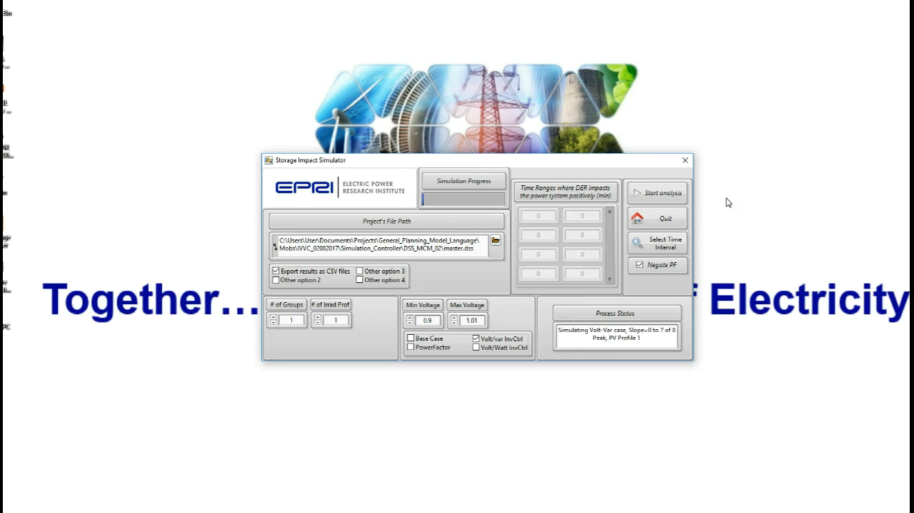
Temporal parallelization
“The computational burden is on the simulation intensity”

Slide 26
Temporal parallelization
Complementary tools
Advanced Graphics Module for OpenDSS (OpenDSS-Viewer)
Developed by Miguel Hernandez (EPRI). Enhance the visualization of Distribution System Simulations with a flexible, scalable and meaningful approach.
https://epri.box.com/s/o4itfn23txv73iyo3y1ukbs9nmgsspgo

Slide 27
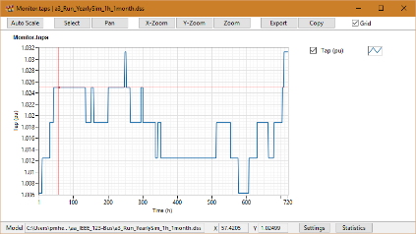
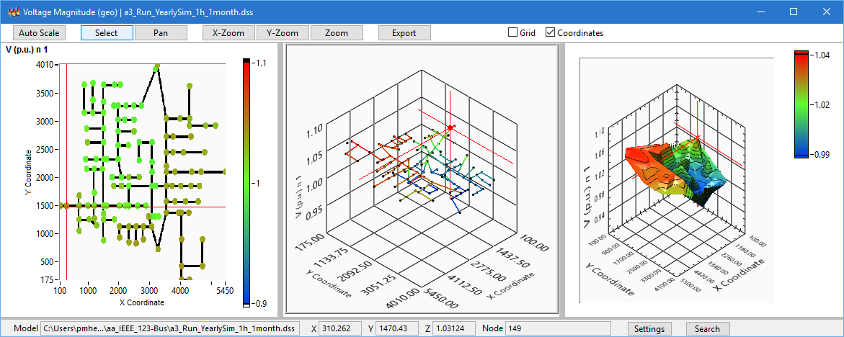
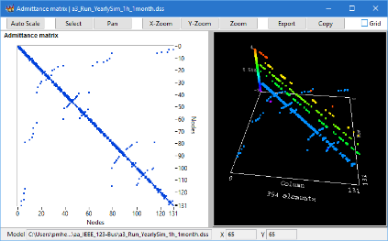
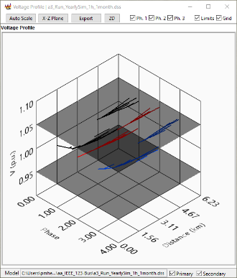
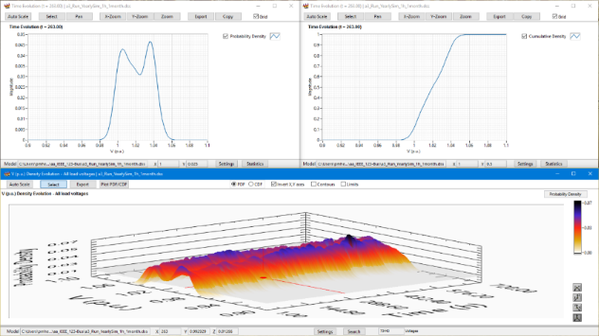
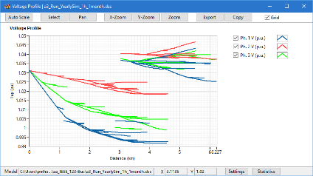
Temporal parallelization
Complementary tools

Slide 28
Actor based Diakoptics (A-Diakoptics)

Slide 29
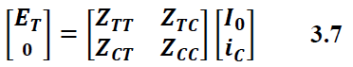
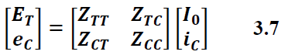
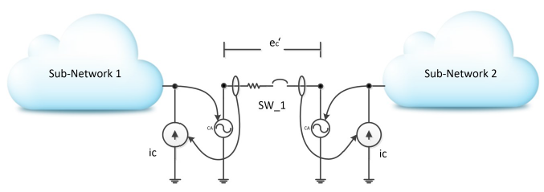
A-Diakoptics
“The computational burden is on the model’s complexity”
Notes:
Remember to compare with slide 23.

Slide 30
A-Diakoptics
“The computational burden is on the model’s complexity”
Diakoptics proposed by G. Kron in the 50’s.
Authors have used it for interconnecting independent system in several domains.
H. Happ proposed a systematic approach based on the Z matrix (Z-Diakoptics).
This approach was initially conceived was to cover systems with multiple excitations.
Notes:
Remember to compare with slide 23.

Slide 31
A-Diakoptics
“The computational burden is on the model complexity”
There are modern methods to solve the power flow problem…
This strategy can be used to generate several solvers working together concurrently…
Each primitive can be solved independently…
This means that the reference vector (currents) will change during the solving process…
Notes:
Remember to compare with slide 23.

Slide 32
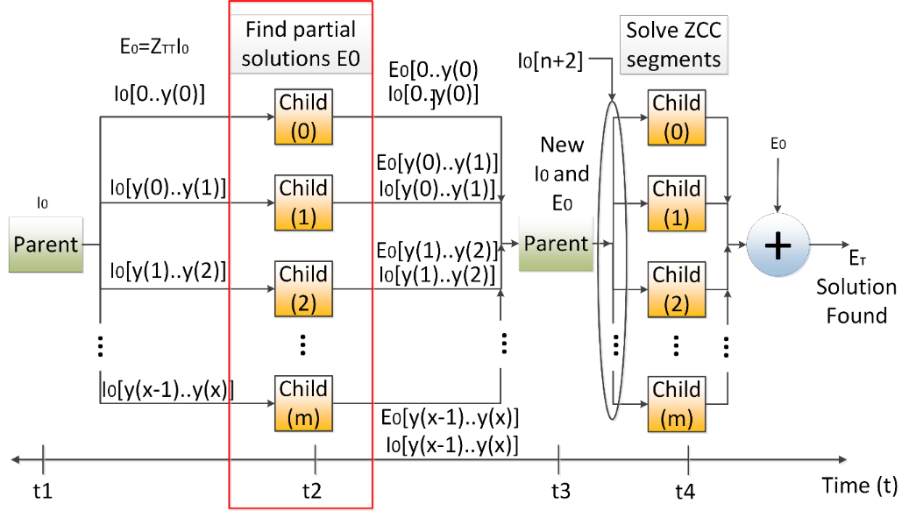
A-Diakoptics
“The computational burden is on the model complexity”
“Multilevel A-Diakoptics for the Dynamic Power Flow Simulation of Hybrid Power Distribution Systems”. D. Montenegro, G. Ramos, S. Bacha.
IEEE Transactions on Industrial Informatics.
“Iterative method for detecting and localizing islands within sparse matrixes using DSSim-RT”. D. Montenegro, G. Ramos.
IEEE PEPQA 2015.
Notes:
Remember to compare with slide 23.

Slide 33
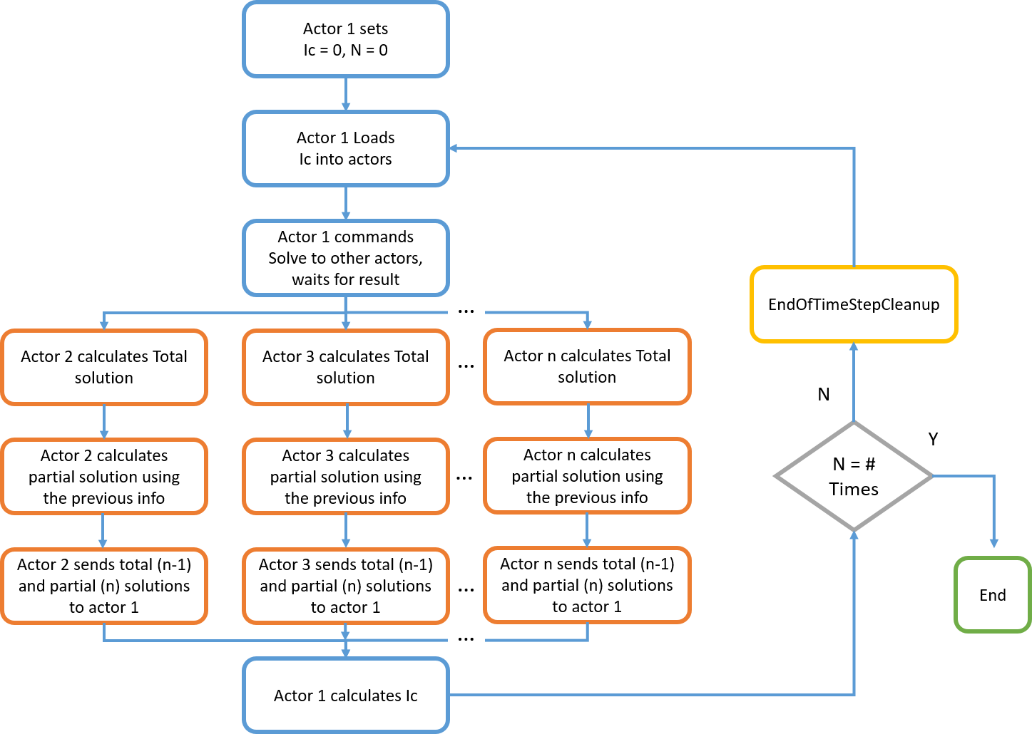
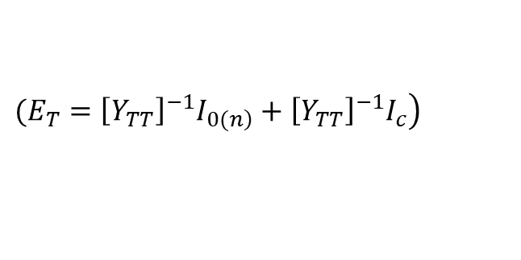
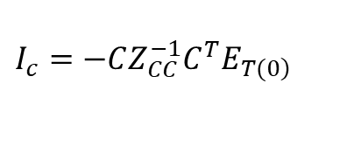
Simplified A-Diakoptics (New)
“The computational burden is on the model complexity”
$$(\left.E_{T}={\left[Y_{TT}\right]}^{−1}I_{\left.0(n\right)}+{\left[Y_{TT}\right]}^{−1}I_{c}\right)$$
$$I_{c}=−CZ_{CC}^{−1}C^{T}E_{\left.T(0\right)}$$
https://sourceforge.net/p/electricdss/code/HEAD/tree/trunk/Version8/Distrib/Doc/A_Diakoptics_Suite.pdf
Notes:
Remember to compare with slide 23.

Slide 34
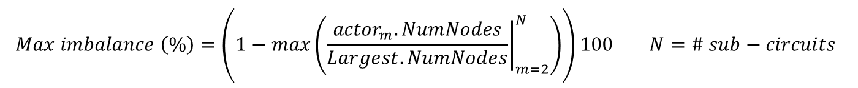
Simplified A-Diakoptics (New)
“The computational burden is on the model complexity”
$$Circuit reduction \left(\%\right)=\left(1−\frac{\max\left({\left.{actor}_{m}.NumNodes\right|}_{m=2}^{N}\right)}{Total_NumNodes}\right)100 N=\# sub−circuits$$
$$Max imbalance \left(\%\right)=\left(1−max\left({\left.\frac{{actor}_{m}.NumNodes}{Largest.NumNodes}\right|}_{m=2}^{N}\right)\right)100 N=\# sub−circuits$$
$$avg imbalance \left(\%\right)=mean\left({\left[1−\left.\frac{{actor}_{m}.NumNodes}{Largest.NumNodes}\right|\right]}_{m=2}^{N}\right)100 N=\# sub−circuits$$
Notes:
Remember to compare with slide 23.

Slide 35
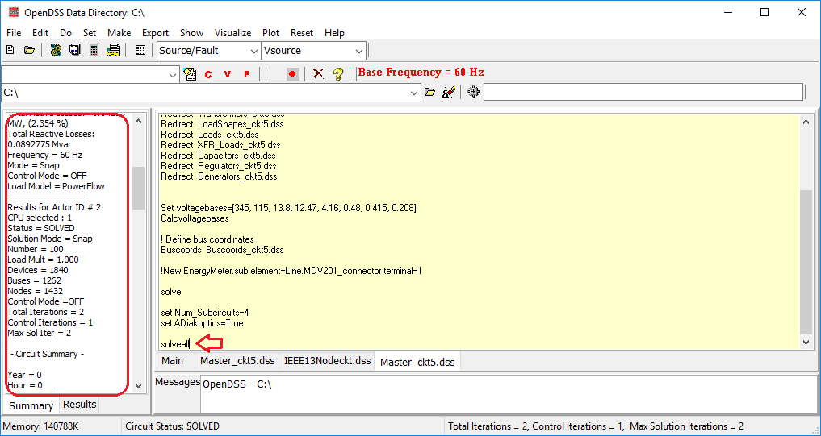
Simplified A-Diakoptics (New)
“The computational burden is on the model complexity”
Circuit reduction (%): 68.52
Max imbalance (%): 42.33
Average imbalance (%): 20.52
Circuit reduction (%): 46.34
Max imbalance (%): 13.64
Average imbalance (%): 6.818
Circuit reduction (%): 60.95
Max imbalance (%): 94.04
Average imbalance (%): 48.67
Notes:
Remember to compare with slide 23.

Slide 36
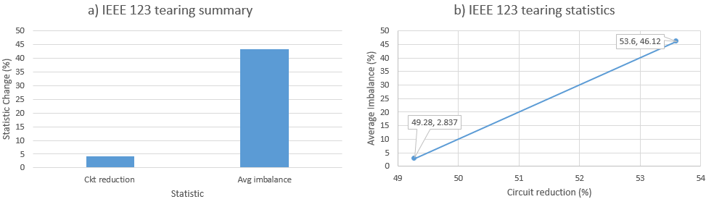
Simplified A-Diakoptics (New)
“The computational burden is on the model complexity”
Notes:
Remember to compare with slide 23.

Slide 37
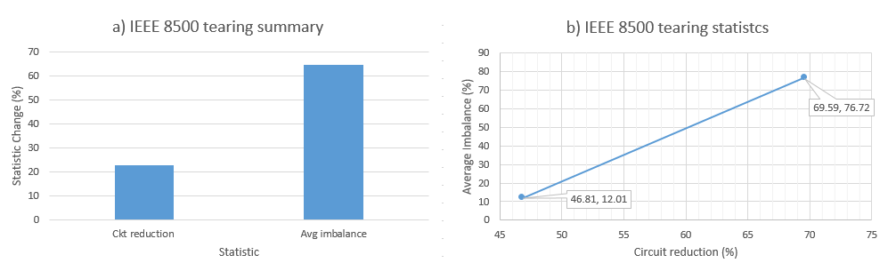
Simplified A-Diakoptics (New)
“The computational burden is on the model complexity”
Notes:
Remember to compare with slide 23.

Slide 38
New features for planning

Slide 39
Seasonal ratings
Setting up the ratings
The new properties added to PDElements are Seasons and Ratings. Seasons refers to the number of ratings that the PDElement will have and Ratings refers to a numerical array for the rating values for the different Seasons. Both values (Seasons and Ratings) need to agree, otherwise the simulation will just take the default value for the rating when needed (the same as NormAmps). The new properties added apply for the following OpenDSS objects:
Line
LineCode
WireData
LineGeometry
CNData
TSData
If not defined, Seasons will be set to one and Ratings will be set to a numerical array of one element containing the NormAmps value.
Notes:
Remember to compare with slide 23.

Slide 40
Seasonal ratings
Setting up the ratings
For example, consider a case where there are two seasons (seasons zero and one), the two seasons will be introduced into a LineGeometry as follows:
New "LineGeometry.556-4/0n" nphases=3 nconds=4 Cond=1 wire=ACSR556 X=-1.243584 h=10.3632 units=m Cond=2 wire=ACSR556 X=0 h=10.52194 units=m Cond=3 wire=ACSR556 X=1.014984 h=10.3632 units=m Cond=4 wire=ACSR4 X=0 h=9.09319 units=m Reduce=Yes Seasons=2 Ratings=[658 924]
The season signal
the index value of the rating defines the season. The season number across the simulation is defined using an XYCurve object. The XYCurve is expected to describe the edges of a curve that changes its value in time. The X axis represents time and the Y axis represents the season.
Consider the previous example, in this case both seasons are summer and winter. The winter season goes from November to April, the other months are considered as summer.
Notes:
Remember to compare with slide 23.

Slide 41
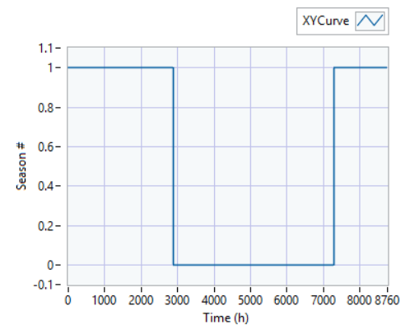
Seasonal ratings
The season signal
The winter season goes from November to April, the other months are considered as summer. The XYCurve for describing these seasons on a simulation will be as follows:
New XYCurve.seasonsrat npts=6 xarray=[0,2880,2881,7296,7297,8760] yarray=[1,1,0,0,1,1]es Seasons=2 Ratings=[658 924]
Notes:
Remember to compare with slide 23.

Slide 42
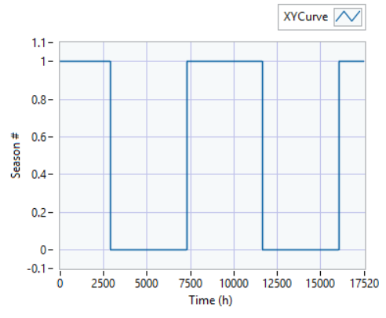
Seasonal ratings
The season signal
The XYCurve will be extrapolated using the last pair (X, Y) defined for the curve if the time exceeds the time defined for the Curve. This means that if your simulation takes more than 1 year and your season signal curve considers only 1 year, the user will have to redefine the season signal curve to cover all the years.
Applying the seasonal ratings into the active circuit
It is necessary to activate the season settings previously described to take effect on the current circuit. The activation can be done using the following OpenDSS commands:
set SeasonSignal=seasonsrat
set SeasonRating=true
Notes:
Remember to compare with slide 23.

